Slide 1
System structure and software design

Slide 2
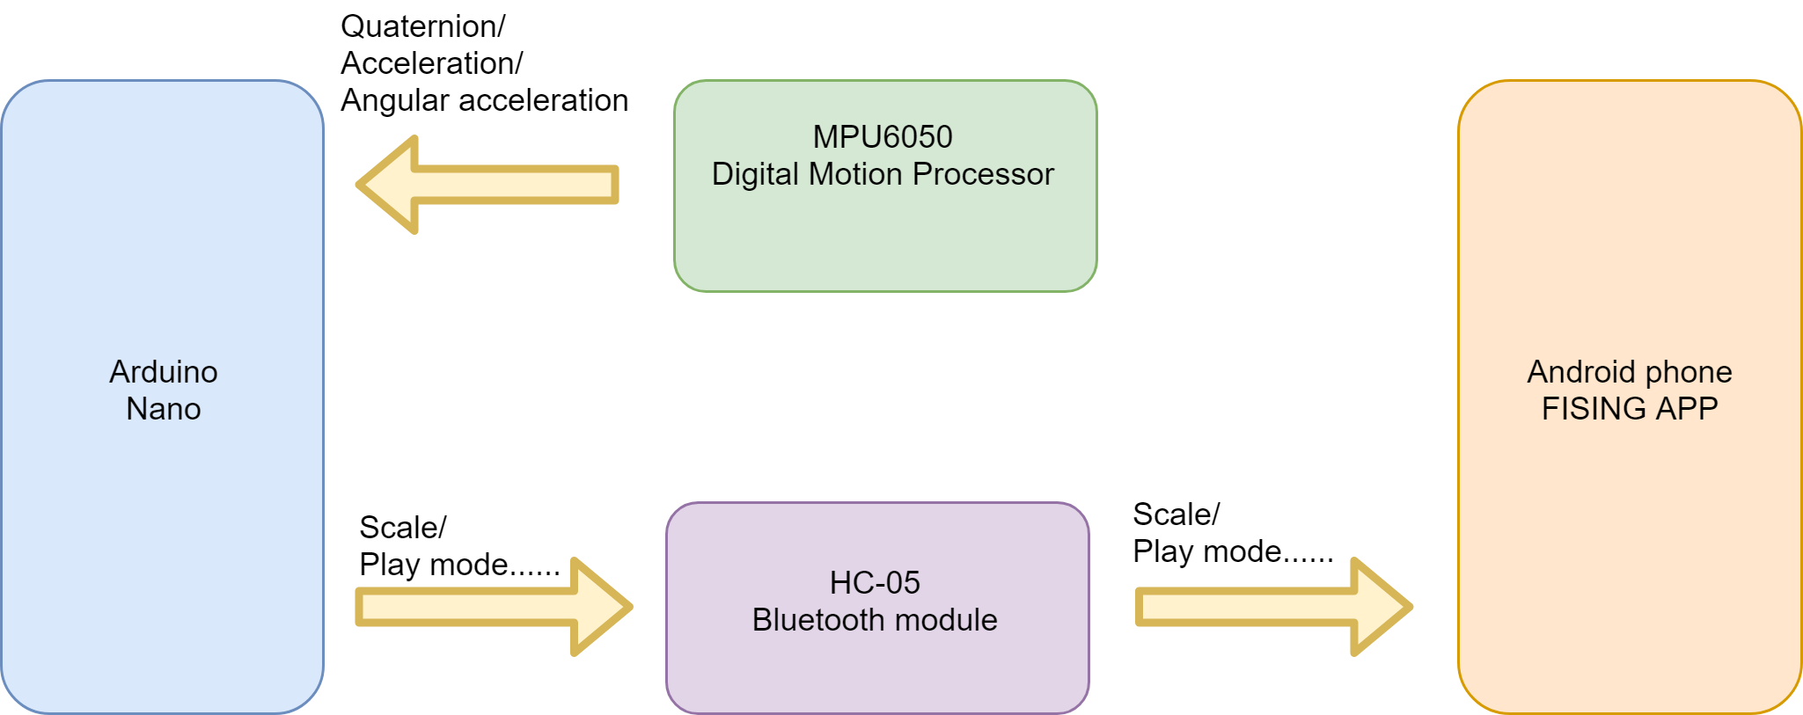
System structure

Slide 3
How to define a complete swing

Slide 4
Observe acceleration data

Slide 5
Observe acceleration data
Accelerate twice in different direction
Two peak value and a local minimum

Slide 6
Definition of a complete swing
With state machine
Acceleration magnitude should exceed threshold value.
Idle
Accelerate
Wait
De-accelerate

Slide 7
How to determine swing direction

Slide 8
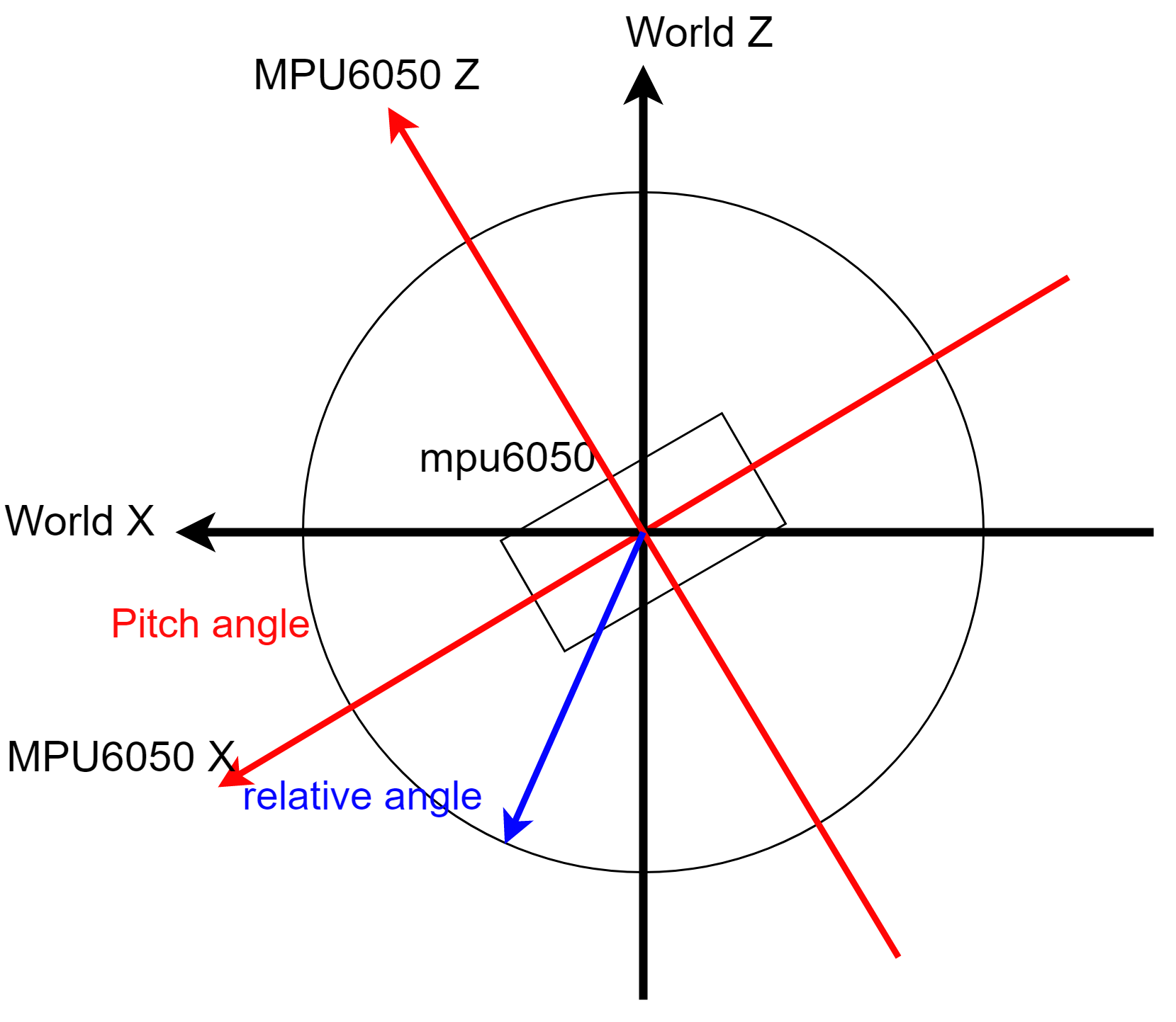
Observe acceleration data again
To simplify the problem, only two axes are considered.

Slide 9
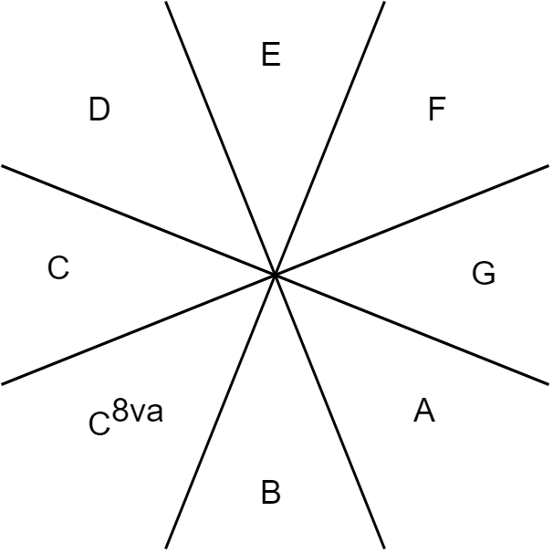
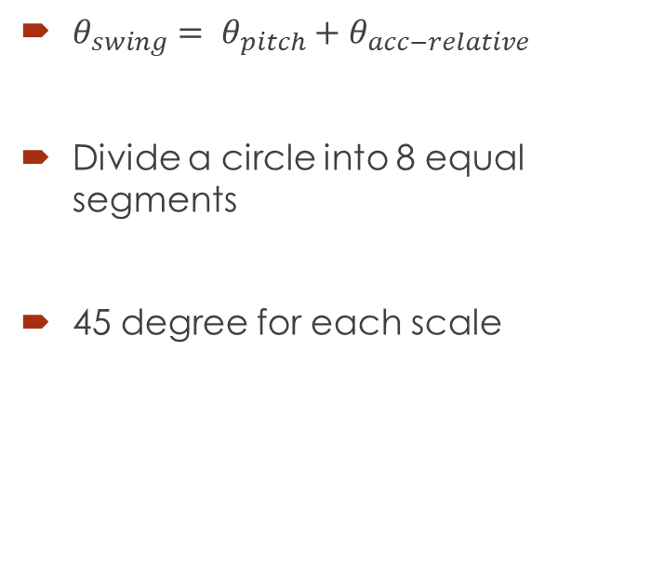
Scale decision
$θ_{swing}= θ_{pitch}+θ_{acc−relative}$
Divide a circle into 8 equal segments
45 degree for each scale

